Slide 1
AI for Medicine
Lecture 4:
A Primer on Molecular Genetics- Part II
and Sequence Alignment
January 19, 2022
Mohammad Hammoud
Carnegie Mellon University in Qatar

Slide 2
Today…
Last Wednesday’s Session:
Introduction to molecular genetics
Today’s Session:
Continue on molecular genetics and switch to related computer science techniques and AI models
Announcement:
Assignment 1 is out. It is due on January 25 by midnight.

Slide 3
Recap: Gene Expression & Central Dogma
A gene can specify a protein through a process known as gene expression, which involves two phases:
Input:
Output/Input:
Output:
Transcription
Translation
Protein-coding
Gene
Messenger RNA
(mRNA)
Polypeptide
Phase I
Phase II
Central Dogma
(i.e., DNA → RNA → Protein directional flow of information)

Slide 4
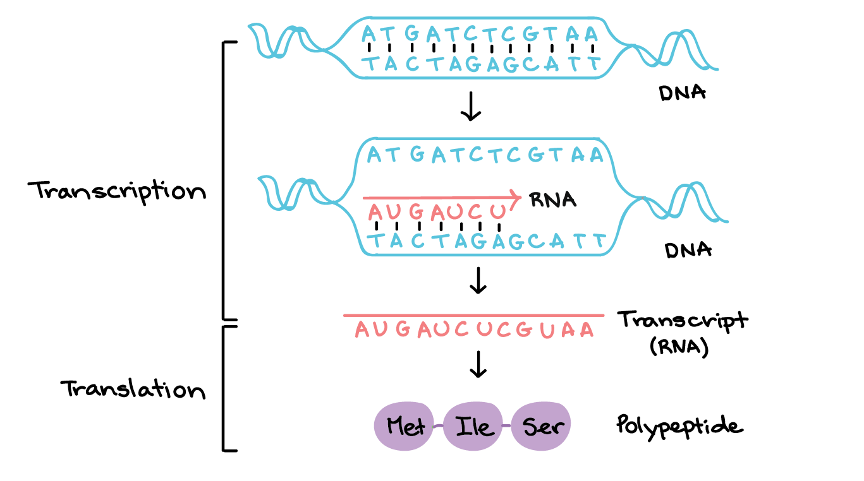
Recap: Gene Expression & Central Dogma
Phase I:
Phase II:

Slide 5
What Happens Next?
Once the polypeptide is finished, it may be processed or modified, combine with other polypeptides, or be shipped to a specific destination inside or outside the cell
Ultimately, it will perform a specific job needed by the cell or organism – perhaps as a signaling molecule, structural element, or enzyme!
E.g., One of the jobs of the liver is to remove toxic substances like alcohol from the bloodstream
To do this, liver cells express genes encoding pieces of an enzyme called alcohol dehydrogenase, which breaks alcohol down into a non-toxic molecule

Slide 6
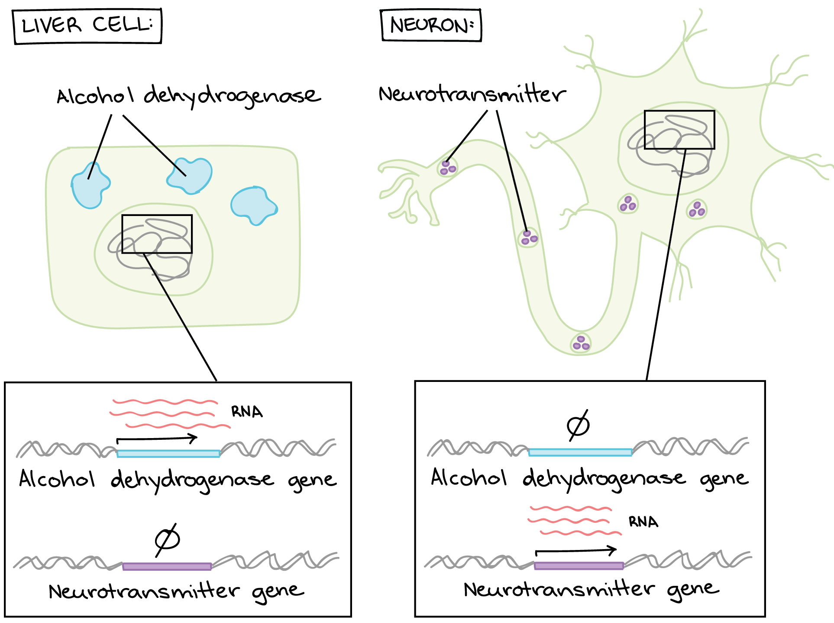
What Happens Next?
The neurons in a person’s brain do not remove toxins from the body, so they keep these genes unexpressed, or “turned off”
Likewise, the cells of the liver do not send signals using neurotransmitters, so they keep neurotransmitter genes turned off

Slide 7
Gene Regulation
But, how do cells decide which genes to “turn on” and which genes to “turn off”?
More interestingly, our amazing bodies contain hundreds of different cell types, from liver cells to immune cells through skin cells to neurons, albeit almost all of them contain the same set of DNA instructions
So why do they look so different and do different jobs?
The answer is simple: different gene regulation!

Slide 8
Gene Regulation
Gene regulation is the process of controlling which genes in a cell's DNA are expressed and which are not
Thanks to gene regulation, each cell type in our bodies has a different set of active genes
This entails different patterns of gene expressions, which results in different sets of proteins, making each cell type uniquely specialized to do its job
Let us see how this happens!

Slide 9
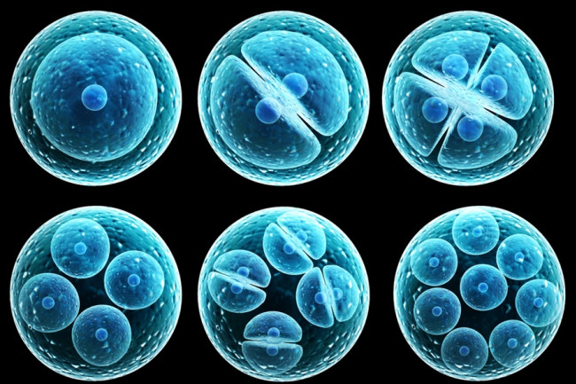
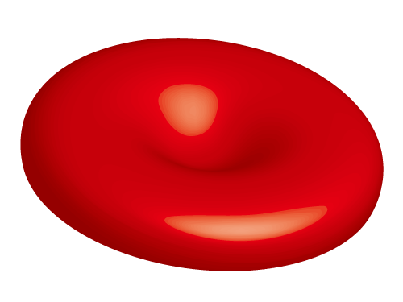
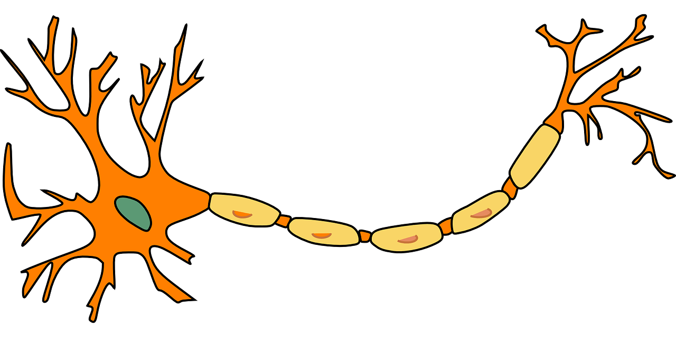
Gene Regulation
Stem Cells
(unspecialized)
Specialized Cells
Muscle Cells
Red Blood Cells
Neuron

Slide 10
Gene Regulation
A Library
(General)
Different people read different books, thus turn to know different subsets of stuff
Specialized People

Slide 11
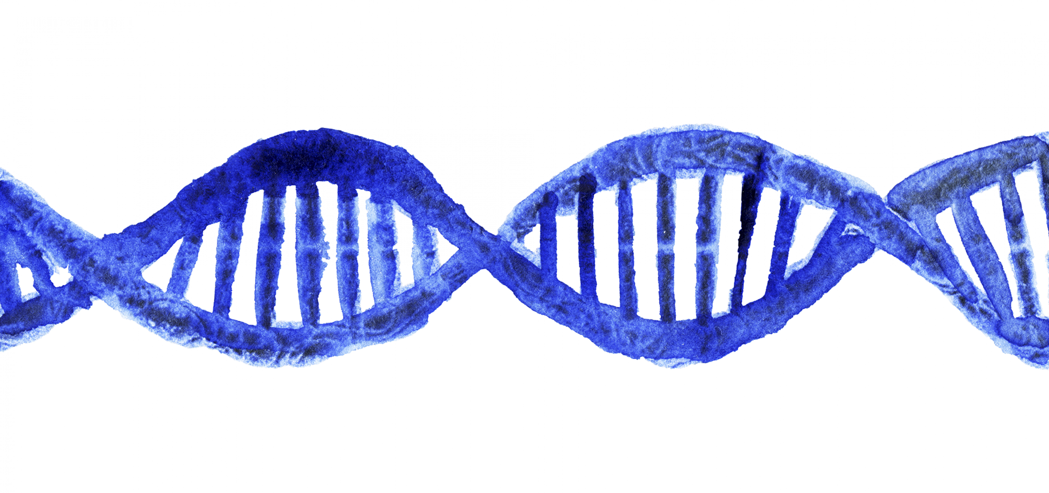
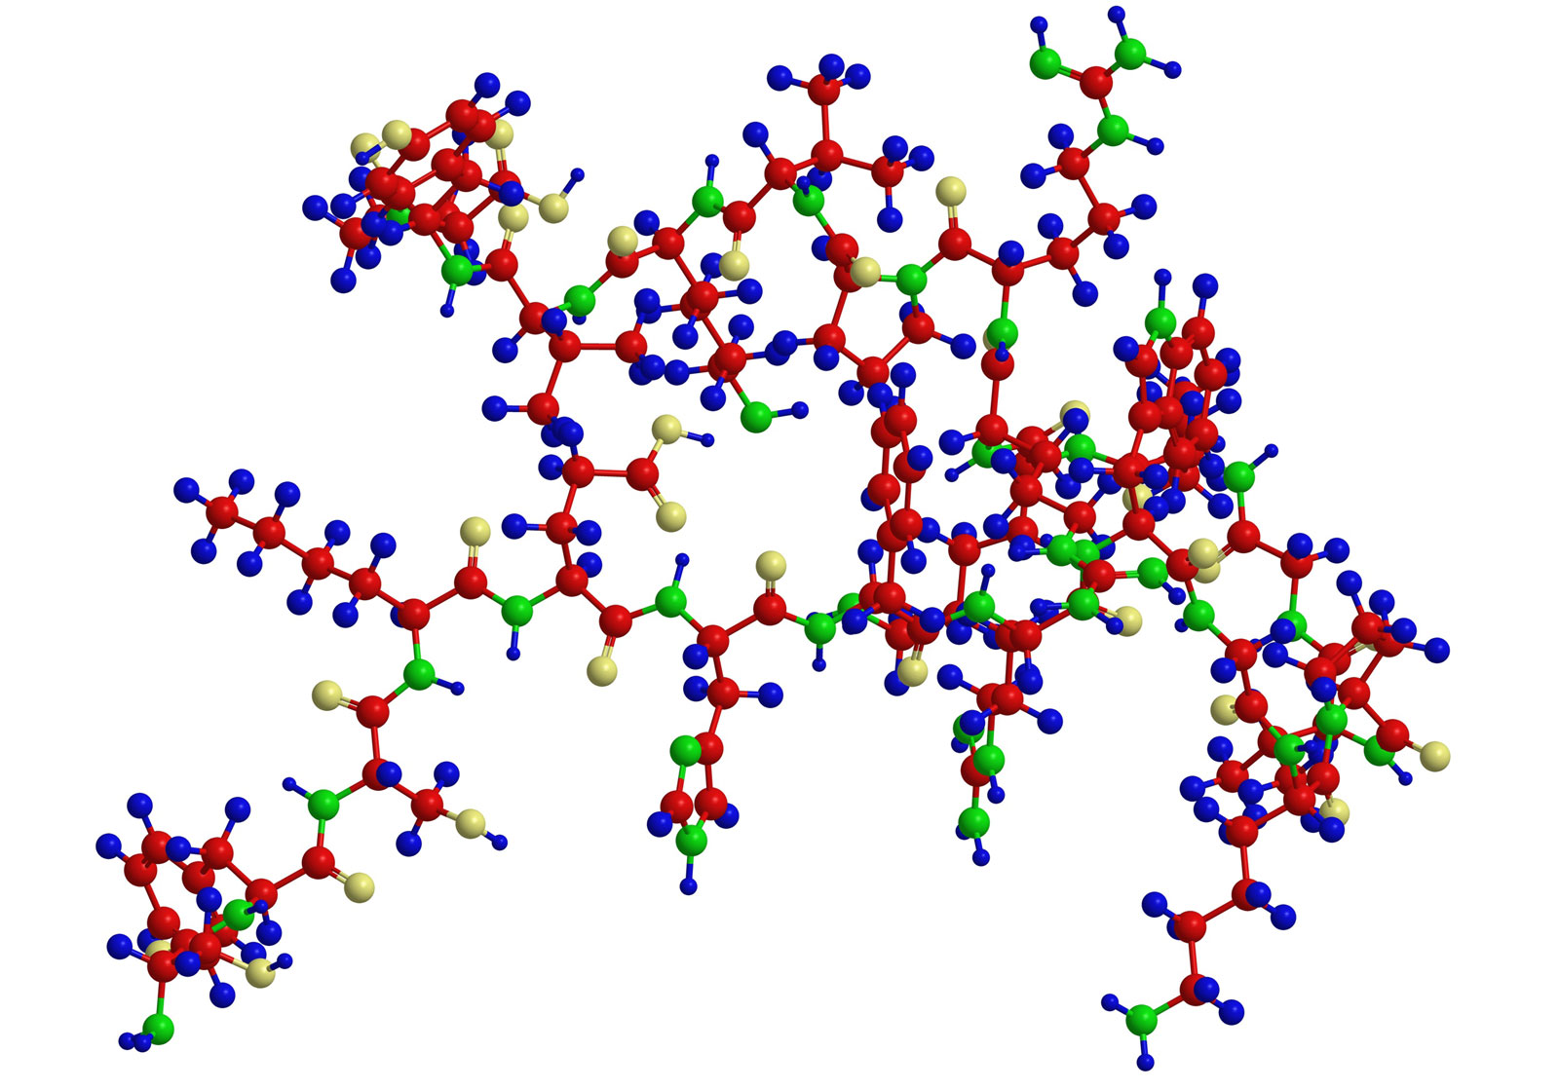
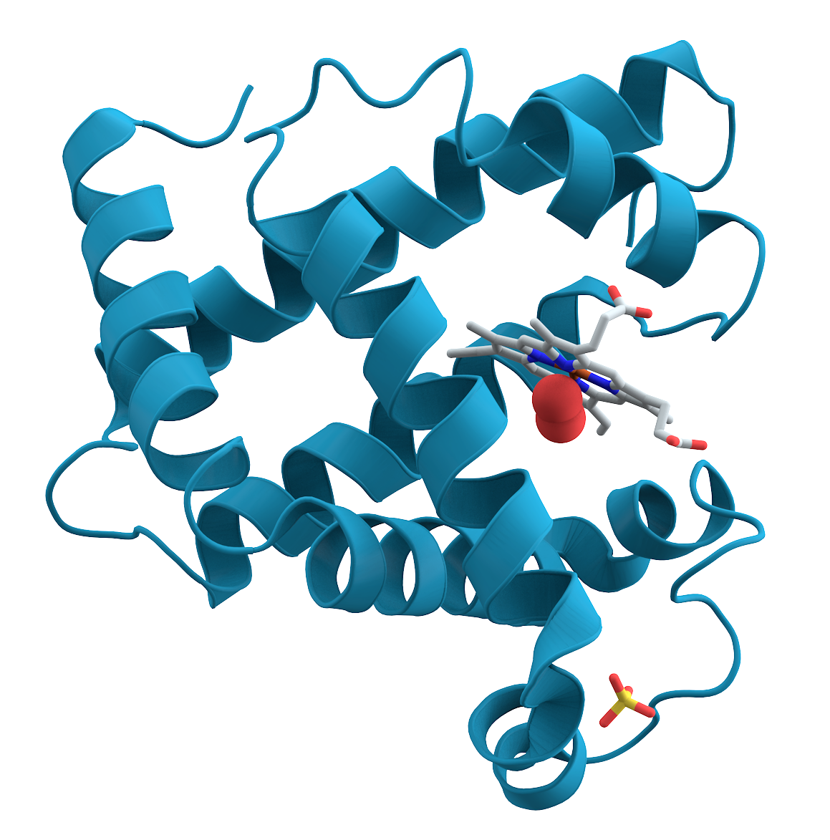
Gene Regulation
Our Library
(DNA or set of genetic instructions for building our entire body)
Our Books
(genes or segments of DNA
which give our cells specific
instructions on how to make
different kinds of protiens)
Gene
Gene
Having different proteins
changes the way our
cells look and function
(e.g., liver cells look and
act different than neurons
because they are reading
different books– genes—
from our library– DNA– to make their proteins)

Slide 12
Gene Regulation
Stem Cells
(unspecialized)
“Turn on” muscle cell genes and “turn off” the rest so that the cell can start producing the proteins it needs to turn it into a muscle cell
Specialized Cells
What helps turning specific genes "on" or "off”?
Muscle Cells
Transcription factors

Slide 13
Transcription Factors
Transcription factors are proteins that regulate the transcription of genes, thus serving in ensuring that the right genes are expressed in the right cells of the body, at the right time
For many genes, transcription is the key on/off control point:
If a gene is not transcribed in a cell, it can't be used to make a protein in that cell
If a gene is transcribed, it will be likely used to make a protein (expressed)
Hence, transcription factors play a central role in regulating transcription

Slide 14
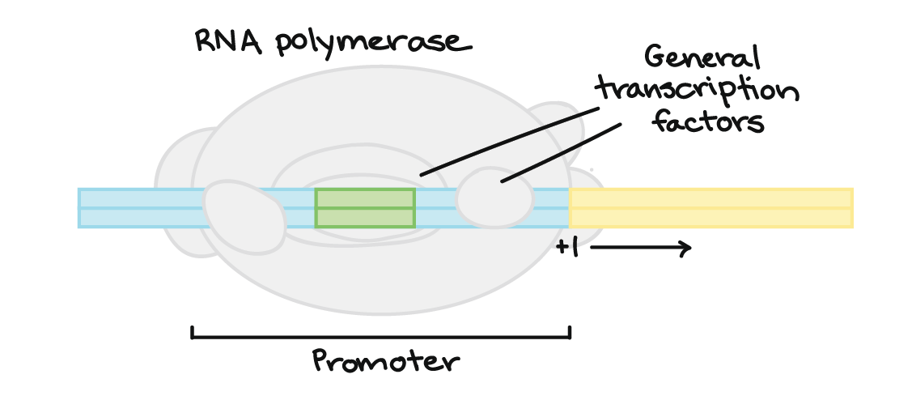
Transcription Factors
What has to happen for a gene to be transcribed?
The enzyme RNA polymerase, which makes a new RNA molecule from a DNA template, must attach to the DNA of the gene
It latches on a spot called the promoter, but only with the help of proteins called basal (general) transcription factors

Slide 15
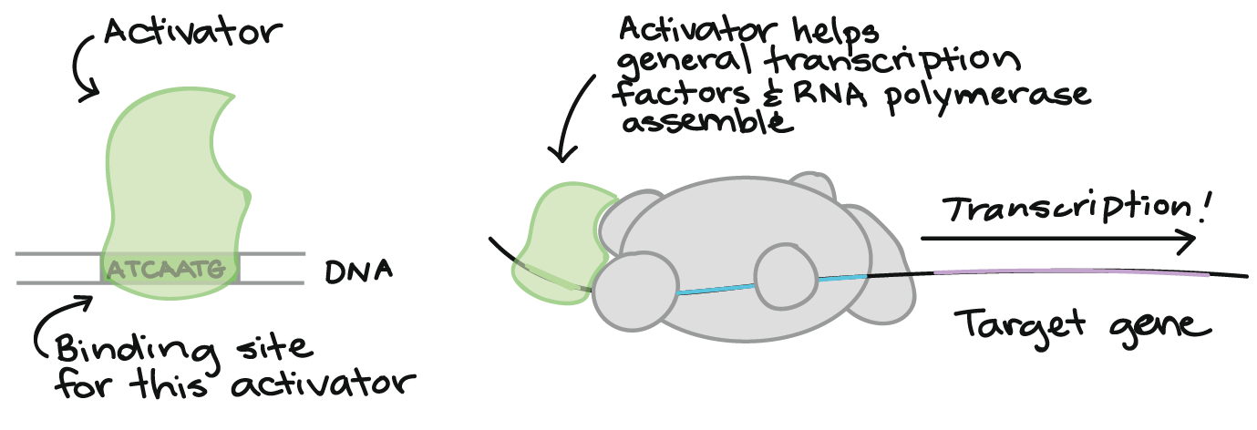
Transcription Factors
A typical transcription factor binds to DNA at a certain target sequence
Once it is bound, it makes it either easier (i.e., activate) or harder (i.e., repress) for RNA polymerase to bind to the promoter of the gene

Slide 16
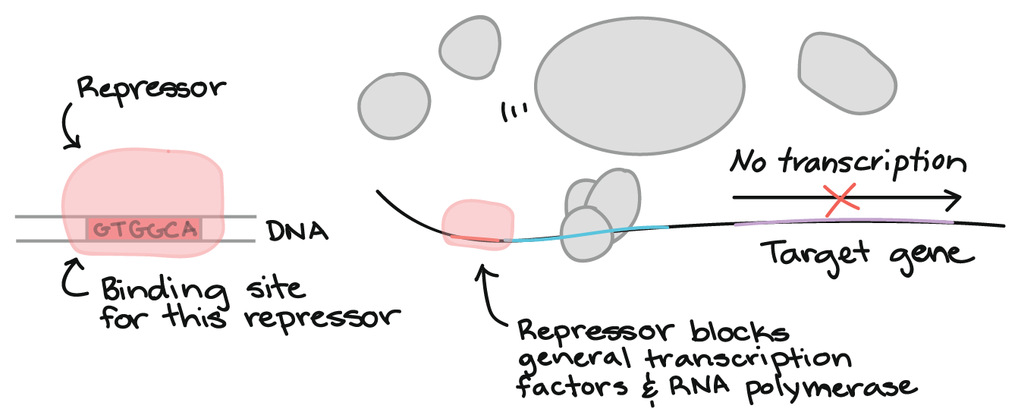
Transcription Factors
A typical transcription factor binds to DNA at a certain target sequence
Once it is bound, it makes it either easier (i.e., activate) or harder (i.e., repress) for RNA polymerase to bind to the promoter of the gene

Slide 17
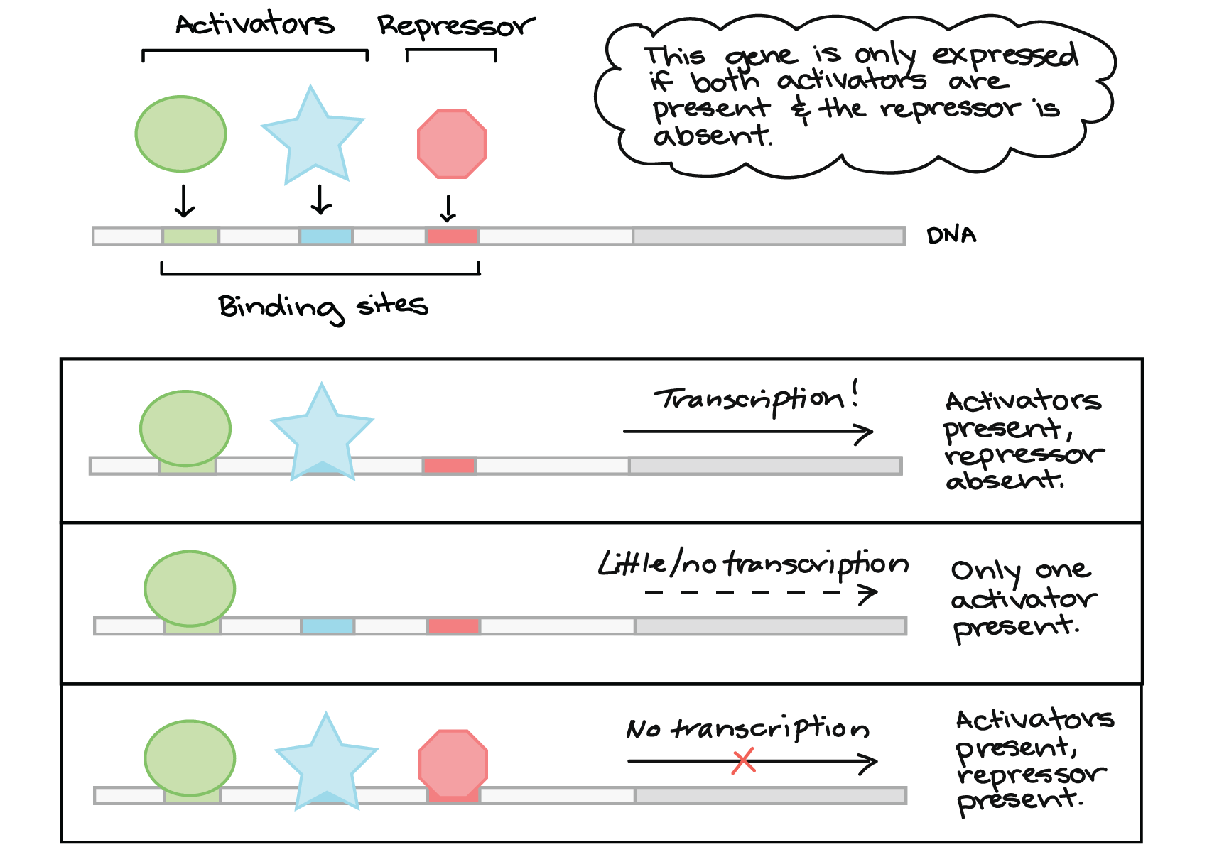
Molecular “Logic”: Combinatorial Regulation

Slide 18
Switching to related CS and AI Concepts…
We can use computers and algorithms to compare DNA sequences and achieve various things, including but not limited to:
Inferring the function of a given new sequence based on its similarity to another known sequence
Finding mutations in a population or family of genes
Finding important molecular regions –conserved across species
https://en.wikipedia.org/wiki/Conserved_sequence

Slide 19
Sequence Alignment
Sequences can be compared through a technique known as sequence alignment
Sequence alignment is a way of arranging sequences of DNA, RNA, or proteins to identify regions of similarity that may entail functional, structural, or evolutionary relationships between the sequences
E.g., If 2 sequences in an alignment share a common ancestor, mismatches can be interpreted as point mutations and gaps as indels (i.e., insertions or deletions) introduced in one or both lineages in the time since they diverged from one another

Slide 20
Sequence Alignment
Two sequences are similar when they "look alike" in some sense
There are several methods for measuring the similarity of two DNA, RNA, or protein sequences
One method is to align two sequences x and y by inserting spaces at arbitrary locations in the two sequences (including at either end) so that the resulting sequences x’ and y’ have the same length, but do not have a space in the same position

Slide 21
Sequence Alignment
Afterwards, we can assign a “score” to each position, say j, in x’ and y’ as follows:
+1 if x’[j] = y’[j] and neither is a space
-1 if x’[j] ≠ y’[j] and neither is a space
-2 if either x’[j] or y’[j] is a space
The score of the alignment can be subsequently computed as the sum of the scores of all the individual positions

Slide 22
Sequence Alignment
Assume the following two sequences:
x = GATCGGCAT
y = CAATGTGAATC
One alignment is:
x:
G |  | A | T | C | G |  | G | C | A | T
C | A | A | T |  | G | T | G | A | A | T | C
y:

Slide 23
Sequence Alignment
Assume the following two sequences:
x = GATCGGCAT
y = CAATGTGAATC
One alignment is:
x:
G |  | A | T | C | G |  | G | C | A | T
C | A | A | T |  | G | T | G | A | A | T | C
-1 | -2 | +1 | +1 | -2 | +1 | -2 | +1 | -1 | +1 | +1 | -2
y:
Position Scores:
Alignment Score = ∑ of all position scores = -4

Slide 24
Sequence Alignment
The best alignment will be the one with the maximum total score
Note: there may be many alignments with the same maximum score
One way to compute the similarity between 2 sequences is to generate all possible alignments and pick the best one
This results in an exponential number of alignments, which yields an intolerably slow algorithm
Fortunately, much faster algorithms exist, which use dynamic programming (studying these algorithms is not in the scope of this class)

Slide 25
Consensus Sequences
An interesting concept known as the consensus sequence has been widely used to represent the specificity of transcription factors
In general, the consensus sequence refers to a sequence that is very similar to many given example sites like protein binding sites
For example, promoters are protein binding sites that are recognized by many transcription factors based on particular patterns, which can be identified by consensus sequences
The more similar the promoter to the consensus sequence, the tighter the RNA polymerase can bind to it and thus facilitate transcription (and vice versa)
Notes:
Recall: Protein binding sites are short sequences of nucleotides that are found at different locations in the genome and play the same role across all of them

Slide 26
Consensus Sequences
But, how can consensus sequences be obtained?
By aligning all known examples of a certain recognition site
E.g., Consider the following 6 Pribnow sequences, which are essential parts of promoters on DNA for transcription to occur in bacteria
TACGAT
TATAAT
TATAAT
GATACT
TATGAT
TATGTT
TACGAT
TATAAT
TATAAT
GATACT
TATGAT
TATGTT
Possible Consensus Sequence | Allowed # of Mismatches | # of Sites Identified
TATAAT | 0 | 2
TATAAT | 1 | 3
TATAAT | 2 | 6
TATRNT | 0 | 4
TATRNT | 1 | 6
Notes:
The Pribnow sequences arealso referred to as -10 regions because they are centered roughly 10 base pairs upstream from the site of initiation of transcription.
Any sequence that differs from the consensus will have a lower score, but the decrease depends on the differences

Slide 27
Consensus Sequences
But, how can consensus sequences be obtained?
By aligning all known examples of a certain recognition site
E.g., Consider the following 6 Pribnow sequences, which are essential parts of promoters on DNA for transcription to occur in bacteria
TACGAT
TATAAT
TATAAT
GATACT
TATGAT
TATGTT
TACGAT
TATAAT
TATAAT
GATACT
TATGAT
TATGTT
Possible Consensus Sequence | Allowed # of Mismatches | # of Sites Identified
TATAAT | 0 | 2
TATAAT | 1 | 3
TATAAT | 2 | 6
TATRNT | 0 | 4
TATRNT | 1 | 6
Notes:
The Pribnow sequences arealso referred to as -10 regions because they are centered roughly 10 base pairs upstream from the site of initiation of transcription.
Any sequence that differs from the consensus will have a lower score, but the decrease depends on the differences

Slide 28
Consensus Sequences
But, how can consensus sequences be obtained?
By aligning all known examples of a certain recognition site
E.g., Consider the following 6 Pribnow sequences, which are essential parts of promoters on DNA for transcription to occur in bacteria
TACGAT
TATAAT
TATAAT
GATACT
TATGAT
TATGTT
TACGAT
TATAAT
TATAAT
GATACT
TATGAT
TATGTT
Possible Consensus Sequence | Allowed # of Mismatches | # of Sites Identified
TATAAT | 0 | 2
TATAAT | 1 | 3
TATAAT | 2 | 6
TATRNT | 0 | 4
TATRNT | 1 | 6
Notes:
The Pribnow sequences arealso referred to as -10 regions because they are centered roughly 10 base pairs upstream from the site of initiation of transcription.
Any sequence that differs from the consensus will have a lower score, but the decrease depends on the differences

Slide 29
Position Weight Matrix
It is easy to find a consensus sequence that identifies a collection of sites, but it is not so straightforward to find one that is optimal for predicting the occurrence of new sites
An alternative to consensus sequences is a weight matrix representation that facilitates predictions of new sites
One column for each position in the Pribnow sequences
A | -38 | 19 | 1 | 12 | 10 | -48
C | -15 | -38 | -8 | -10 | -3 | -32
G | -13 | -48 | -6 | -7 | -10 | -48
T | 17 | -32 | 8 | -9 | -6 | 19
One row for each nucleotide
Notes:
In theory, you can go from concensus sequence to a position weight matrix but not vice versa.
The above matrix does not come from the six examples shown in the previous slide, but rather is based on a much larger collection of −10 regions that were published several years later after these 6 ones.

Slide 30
Position Weight Matrix
It is easy to find a consensus sequence that identifies a collection of sites, but it is not so straightforward to find one that is optimal for predicting the occurrence of new sites
An alternative to consensus sequences is a weight matrix representation that facilitates predictions of new sites
One column for each position in the Pribnow sequences
A | -38 | 19 | 1 | 12 | 10 | -48
C | -15 | -38 | -8 | -10 | -3 | -32
G | -13 | -48 | -6 | -7 | -10 | -48
T | 17 | -32 | 8 | -9 | -6 | 19
But, how to determine the values in the matrix cells?
One row for each nucleotide
Score of TATAAT = 17 + 19 + 8 + 12 + 10 + 19 = 85

Slide 31
Next Lecture…
Next week, on Wednesday, we will study a machine learning technique to determine the values in position weight matrices

Slide 32
References
[1] https://www.khanacademy.org/
[2] Stormo, Gary D. "DNA binding sites: representation and discovery." Bioinformatics 16.1 (2000): 16-23
[3] Cormen, Thomas H., et al. Introduction to algorithms. MIT press, 2009
[4] Setubal, Joao Carlos, Joao Meidanis, and Setubal-Meidanis. Introduction to computational molecular biology. No. 04; QH506, S4.. Boston: PWS Pub., 1997

